Slide 1
C++(UE22CS221A)
Mini Project

Slide 2
Project Title & Team Members
Title: Hangman
Team Members (SRN Name)
Janvi Munshi(PES2UG22CS231)
Khushi P(PES2UG22CS264)
Mahika Datta (PES2UG22CS292)
Maitri Shekhda(PES2UG22CS294)

Slide 3
Project Description
Synopsis:
The Hangman game is a fun text-based game where you try to guess a hidden word.
Game Setup: The game welcomes you and sets up a secret word, which is initially "hangman“. You have 7 tries to guess the word or individual letters.
Guess the Word: You can choose to guess the entire word. If your guess matches the secret word you win! The game celebrates your correct guess. If your guess is wrong, the game lets you know, and it takes away one of your tries.
Guess the Letter: Alternatively, you can choose to guess a single letter. If your guessed letter is in the secret word the game tells you it's a correct guess. It also shows you where the letter appears in the word. If your letter is not in the word, the game lets you know it's an incorrect guess and takes away one of your tries.

Slide 4
Project Description
Game Continues: The game keeps going until you either correctly guess the entire word or run out of tries. If you win, the game congratulates you and reveals the correct word. If you run out of tries, the game tells you it's over and shows you the correct word.
Importing Words from an External File: The game imports words from an external file. This file would have a bunch of words, each on a new line, like a list .The game would randomly choose a word from this file at the beginning of each round. This way, you get different words each time you play, making the game more exciting.
How to Play: You have 7 tries to guess the word or letters.
Choose:
Option 1: Guess the entire word.
Option 2: Guess a single letter. The game will guide you, and you can see your progress.
Win by guessing the word or lose by running out of tries.

Slide 5
Project Title & Team Members
ADT used:
Insertion
Fetching from text file

Slide 6

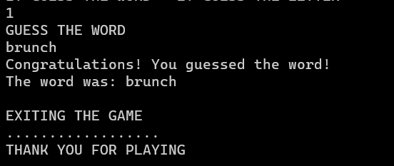
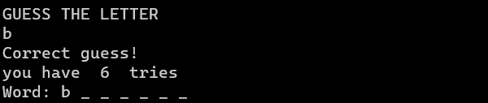
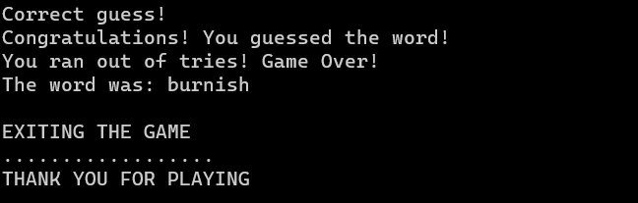
Project Title & Team Members

Slide 7
Contribution of each Team Member
This should be last slide mentioning contribution of each member
Janvi – Guessing letters of the word
Khushi – User Interface
Mahika – Guess the entire word
Maitri – Choosing a word randomly from the file

